Slide 1

Customer Segmentation Final Project
Virtual Internship
Ece Yavuzyılmaz
16-July-2023

Slide 2

Project | Customer Segmentation
Submitted By | Ece Yavuzyılmaz
Email | eceyavuzyilmaz@gmail.com
Country | Turkey
Specialization | Data Analyst
Internship Batch | LISUM21
Data | 16 July 2023

Slide 3
Agenda
Problem Statement
Data Information
Data Understanding
Exploratory Data Analysis (EDA)
Modeling Technique
Recommendations

Slide 4
Problem Statement
1.Problem Description
XYZ bank wants to roll out Christmas offers to their customers. But Bank does not want to roll out same offer to all customers instead they want to roll out personalized offer to particular set of customers. If they manually start understanding the category of customer then this will be not efficient and also they will not be able to uncover the hidden pattern in the data (pattern which group certain kind of customer in one category). Bank approached ABC analytics company to solve their problem. Bank also shared information with ABC analytics that they don't want more than 5 group as this will be inefficient for their campaign.
2.Business Understanding
ABC analytics proposed customer segmentation approach to Bank. ABC analytics assigned this talk to their analytics team and instructed their team to come up with the approach and feature which group similar behavior customer in one category and others in different category.

Slide 5
Data Information
Total number of observations | 1000000
Total number of files | 1
Total number of features | 48
Base format of the file | csv
Size of the data | 154 MB
Total number of observations | 1000000
Total number of files | 1

Slide 6
fecha_dato: The table is partitioned for this column ncodpers: Customer code ind_empleado: Employee index: A active, B ex employed, F filial, N not employee, P pasive pais_residencia: Customer's Country residence sexo: Customer's sex age: Age fecha_alta: The date in which the customer became as the first holder of a contract in the bank ind_nuevo: New customer Index. 1 if the customer registered in the last 6 months. antiguedad: Customer seniority (in months) indrel: 1 (First/Primary), 99 (Primary customer during the month but not at the end of the month) ult_fec_cli_1t: Last date as primary customer (if he isn't at the end of the month) indrel_1mes: Customer type at the beginning of the month ,1 (First/Primary customer), 2 (co-owner ),P (Potential),3 (former primary), 4(former co-owner) tiprel_1mes: Customer relation type at the beginning of the month, A (active), I (inactive), P (former customer),R (Potential)
Data Information

Slide 7
indresi: Residence index (S (Yes) or N (No) if the residence country is the same than the bank country) indext: Foreigner index (S (Yes) or N (No) if the customer's birth country is different than the bank country) conyuemp: Spouse index. 1 if the customer is spouse of an employee canal_entrada: channel used by the customer to join indfall: Deceased index. N/S tipodom: Addres type. 1, primary address cod_prov: Province code (customer's address) nomprov: Province name ind_actividad_cliente: Activity index (1, active customer; 0, inactive customer)
renta: Gross income of the household ind_ahor_fin_ult1: Saving Account ind_aval_fin_ult1: Guarantees ind_cco_fin_ult1: Current Accounts ind_cder_fin_ult1: Derivada Account ind_cno_fin_ult1: Payroll Account ind_ctju_fin_ult1: Junior Account ind_ctma_fin_ult1: Más particular Account ind_ctop_fin_ult1: particular Account
Data Information

Slide 8
Data Information
ind_ctpp_fin_ult1: Particular Plus Account ind_deco_fin_ult1: Short-term deposits ind_deme_fin_ult1: Medium-term deposits ind_dela_fin_ult1: Long-term deposits ind_ecue_fin_ult1: e-account ind_fond_fin_ult1: Funds ind_hip_fin_ult1: Mortgage ind_plan_fin_ult1: Pensions ind_pres_fin_ult1: Loans ind_reca_fin_ult1: Taxes ind_tjcr_fin_ult1: Credit Card ind_valo_fin_ult1: Securities ind_viv_fin_ult1: Home Account ind_nomina_ult1: Payroll ind_nom_pens_ult1: Pensions ind_recibo_ult1: Direct Debit

Slide 9
Task
1. Business Understanding
2. Data Understanding
3. EDA
4. Feature Engineering
4. Model Building
5. Model Evaluation
6. Presentation (Recommendation slide is must)
7. Document the challenges

Slide 10
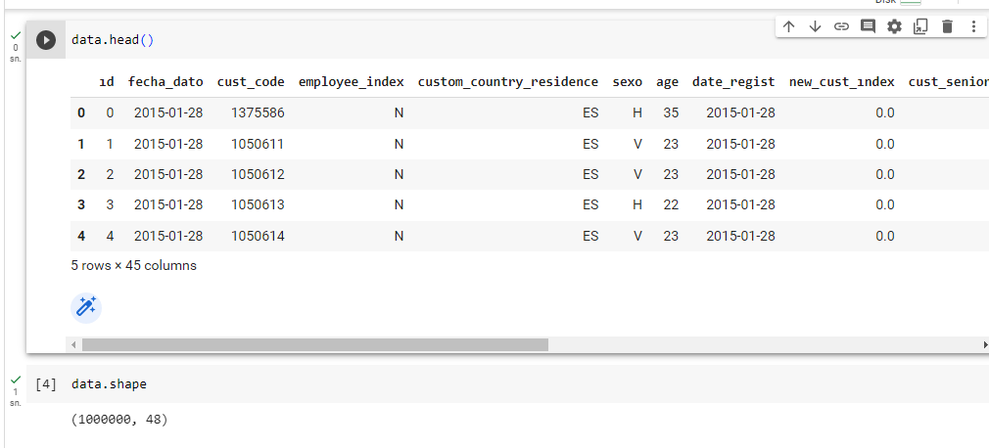
Data Understanding
The dataset consists of 48 columns and 1000000 rows.

Slide 11
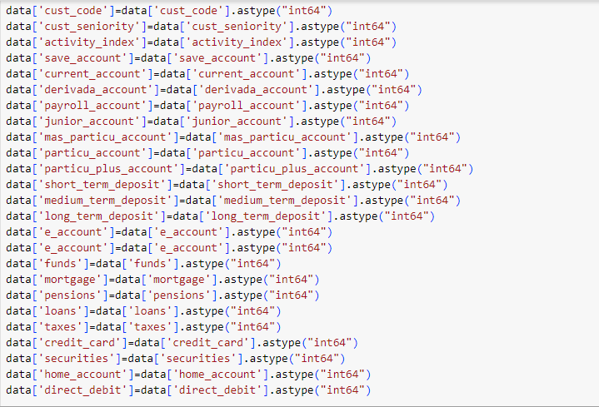
Data Understanding
All data types are seen as 'objects'. These data types have been changed as datetime64[ns] (2), float64 (3), int64 (29), object (11).

Slide 12
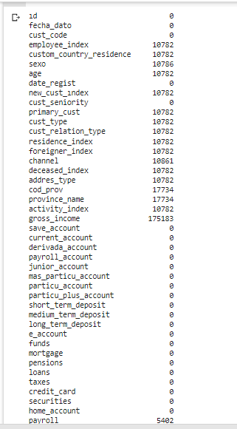
Data Understanding
Missing Values
Two different methods were used to fill in the missing value. These methods are; fillna() and interpolate().

Slide 13
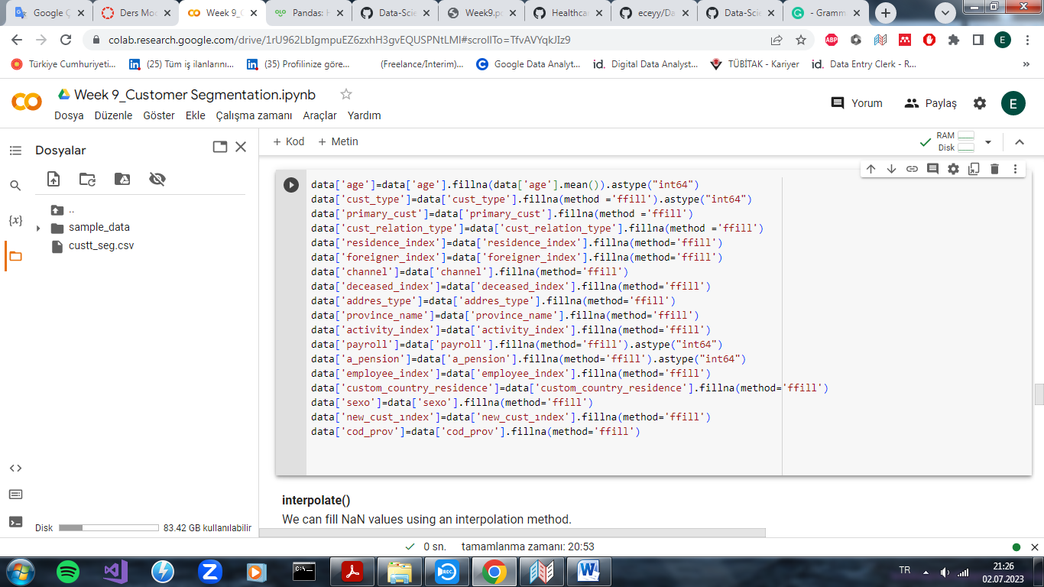
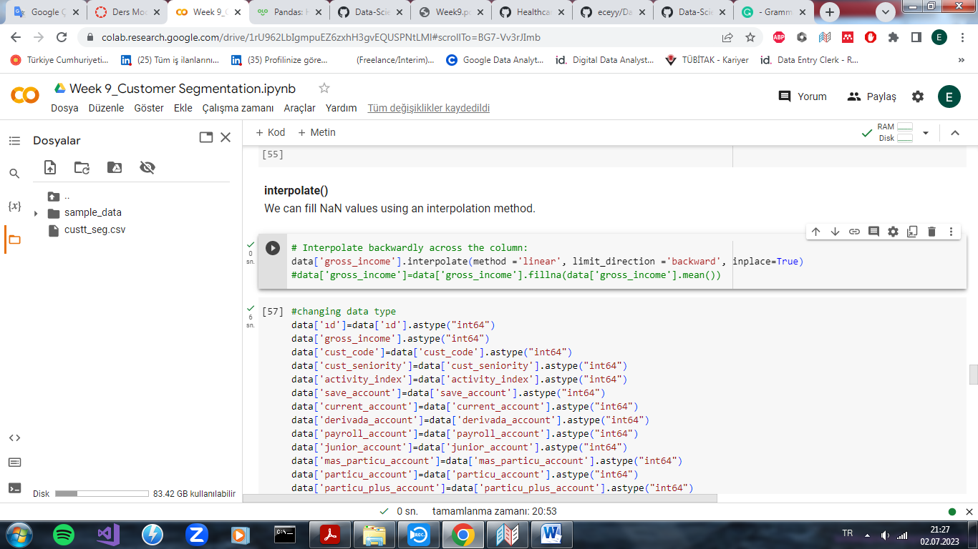
Data Understanding
fillna(): We can use fillna() function to fill NaN values. In this here, we can use different methods such 'backfill', 'bfill','pad','ffill' and mean/median/mode based approach to fill the missing values.
interpolate()

Slide 14
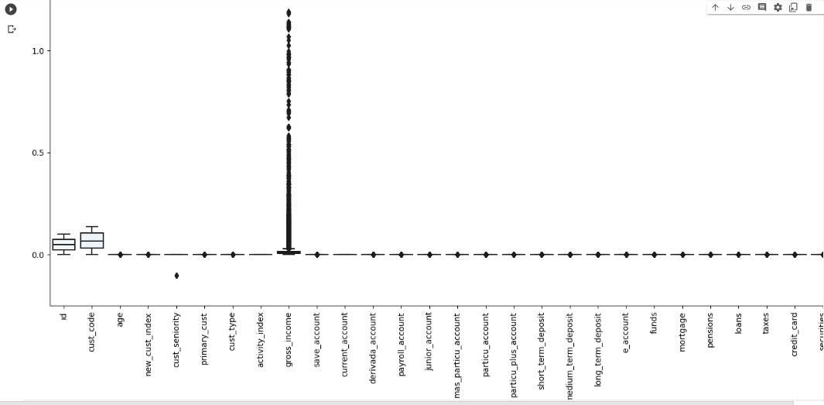
Data Understanding
Outlier Detection

Slide 15
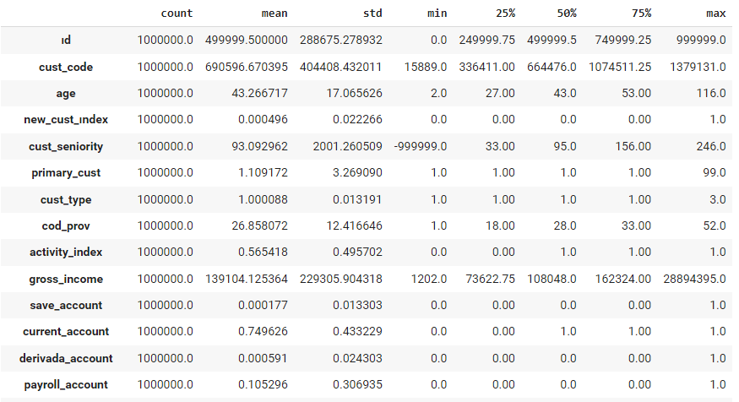
Exploratory Data Analysis (EDA)
Data Describe

Slide 16
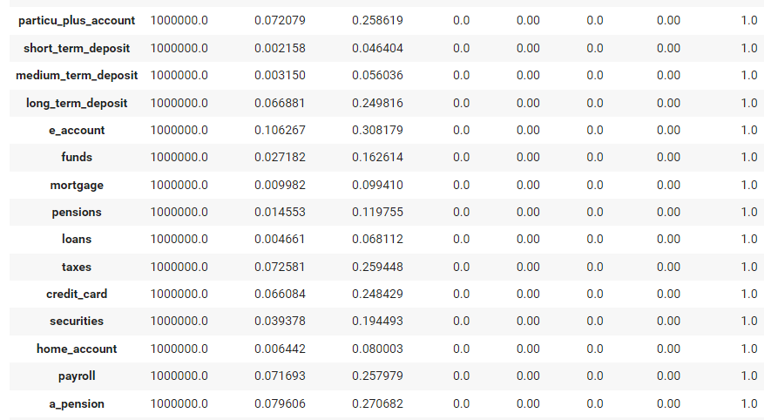
Exploratory Data Analysis (EDA)
Data Describe

Slide 17
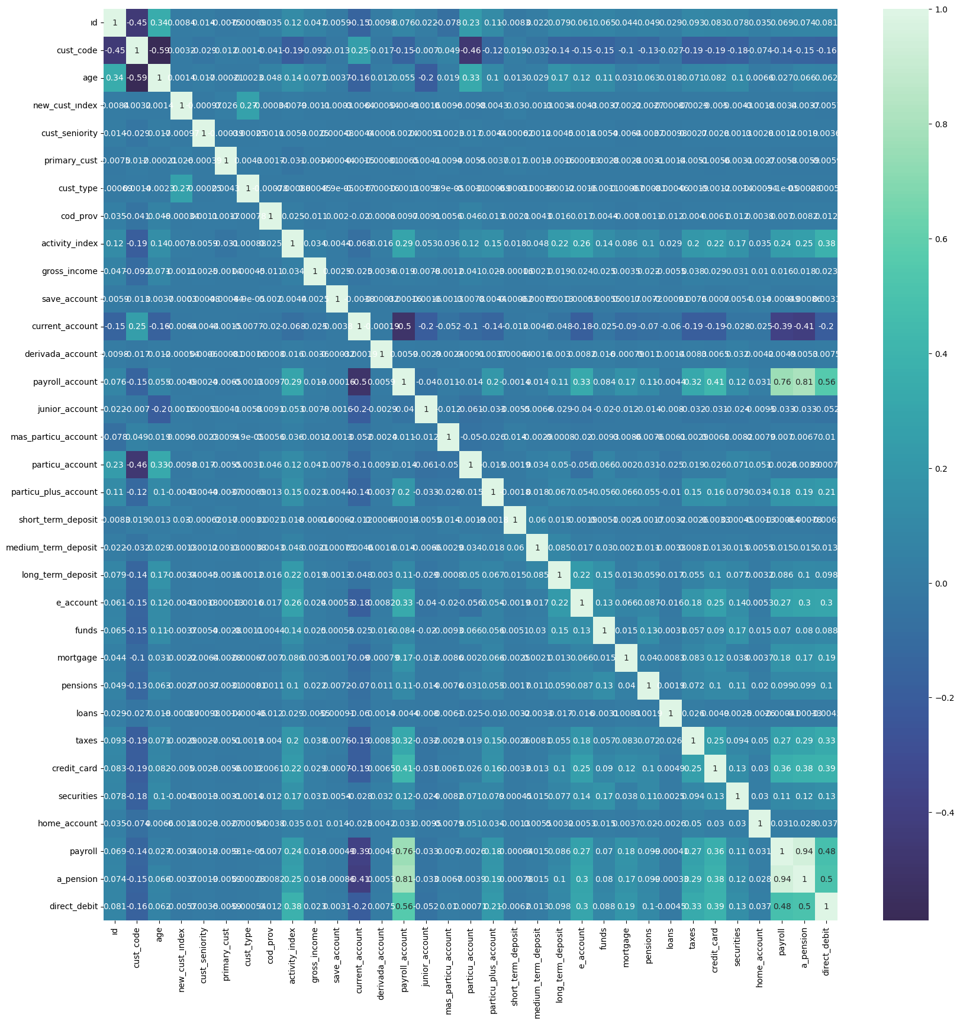
Exploratory Data Analysis (EDA)
The two features with the strongest correlation in the dataset are ‘Payroll' and ‘Pensions’ with 0.94.
It is seen that there is a strong positive correlation with 0.81 correlation between ‘Pensions' and ‘Payroll Account' features.

Slide 18
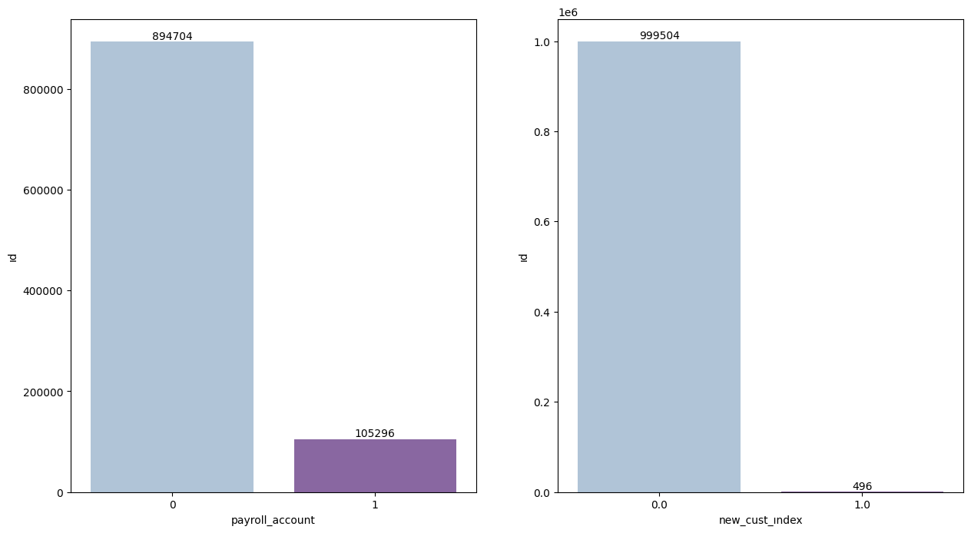
Exploratory Data Analysis (EDA)
Here, payroll account shows the number of payroll accounts of customers registered with the bank, and the new customer index shows the number of customers registered in the last 6 months.

Slide 19
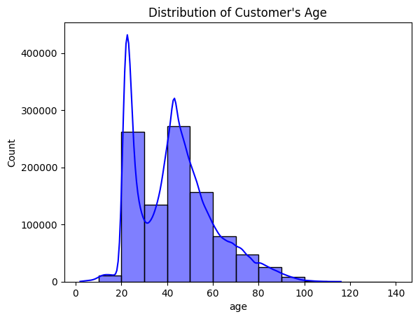
Exploratory Data Analysis (EDA)
In this here, we is seen that most of the customers belong in the age range of 20-60.

Slide 20
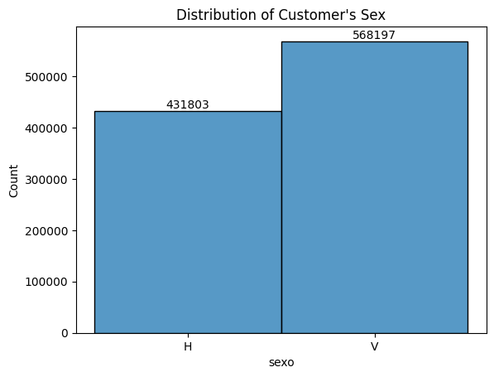
Exploratory Data Analysis (EDA)
This chart shows the sex distribution of customers. 431.803 of the customers are female, and 568.197 are male.

Slide 21
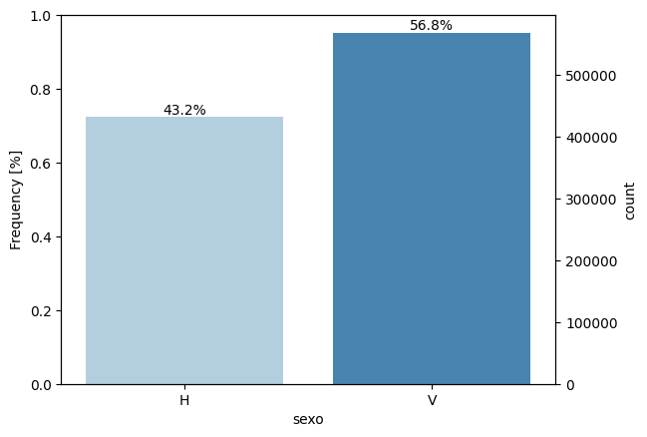
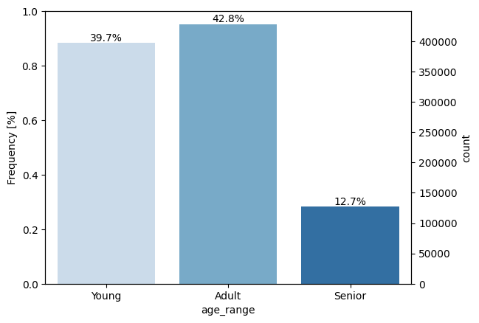
Exploratory Data Analysis (EDA)
Here, the frequency distributions of customers by gender and age are shown. The number of adult customers is higher.

Slide 22
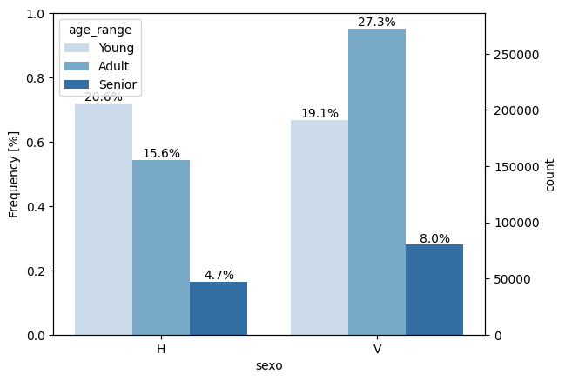
Exploratory Data Analysis (EDA)
While the rate of young customers is higher in females, the rate of adult customers is higher in males.

Slide 23
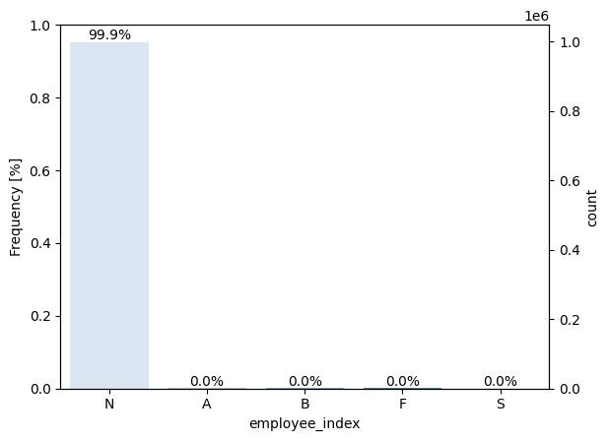
Exploratory Data Analysis (EDA)
99% of customers are not bank employees.(employee index: A active, B ex employed, F filial, N not employee, P passive)

Slide 24
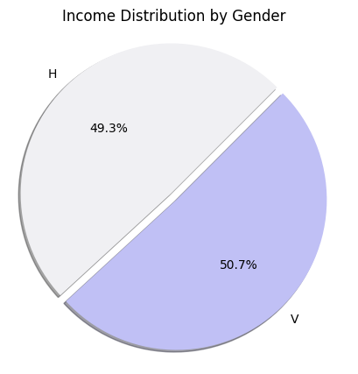
Exploratory Data Analysis (EDA)
When we look at the average income distribution, it is seen that this rate is slightly higher in males.

Slide 25
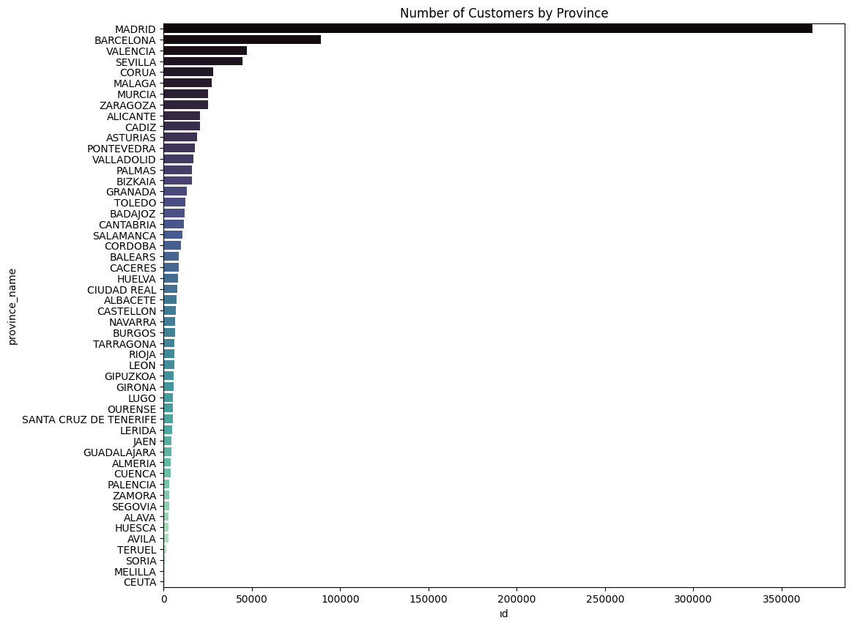
Exploratory Data Analysis (EDA)

Slide 26
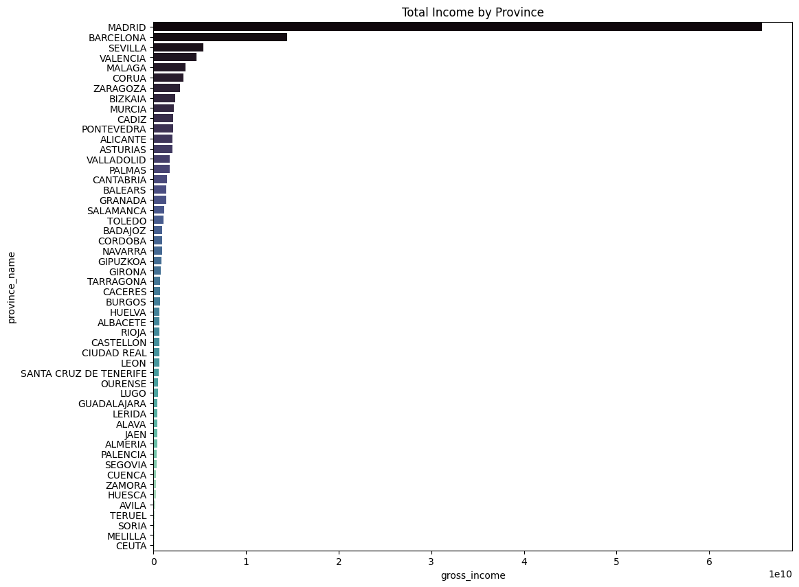
Exploratory Data Analysis (EDA)

Slide 27
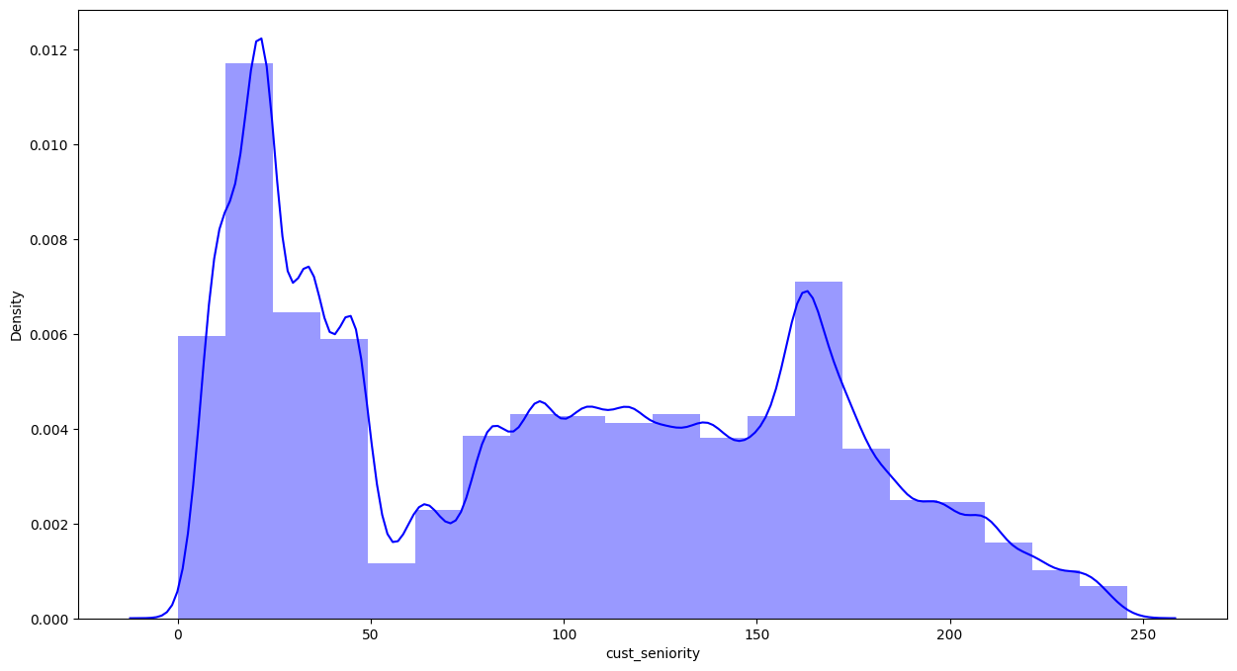
Exploratory Data Analysis (EDA)
Customer seniority (in months)

Slide 28
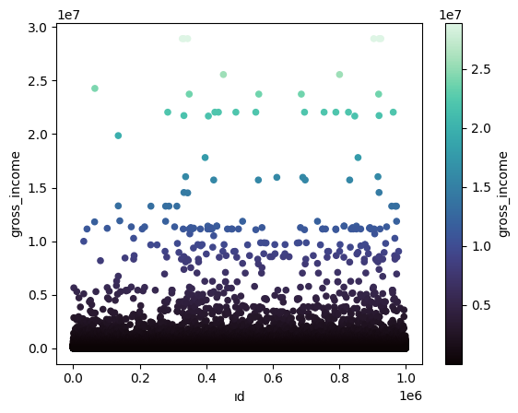
Exploratory Data Analysis (EDA)
gross income distribution

Slide 29
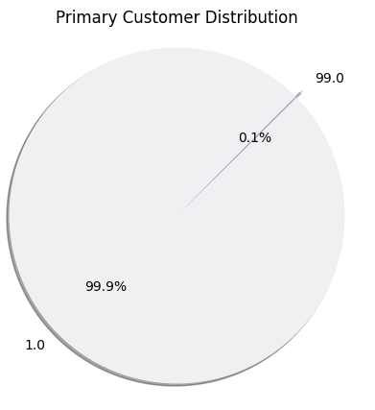
Exploratory Data Analysis (EDA)

Slide 30
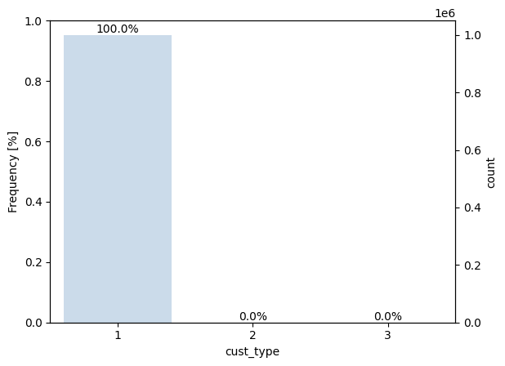
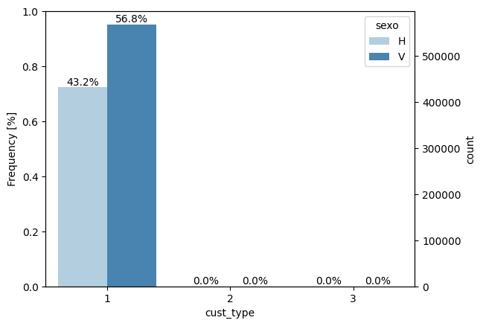
Exploratory Data Analysis (EDA)
Customer type at the beginning of the month ,1 (First/Primary customer), 2 (co-owner ),P (Potential),3 (former primary), 4(former co-owner)

Slide 31
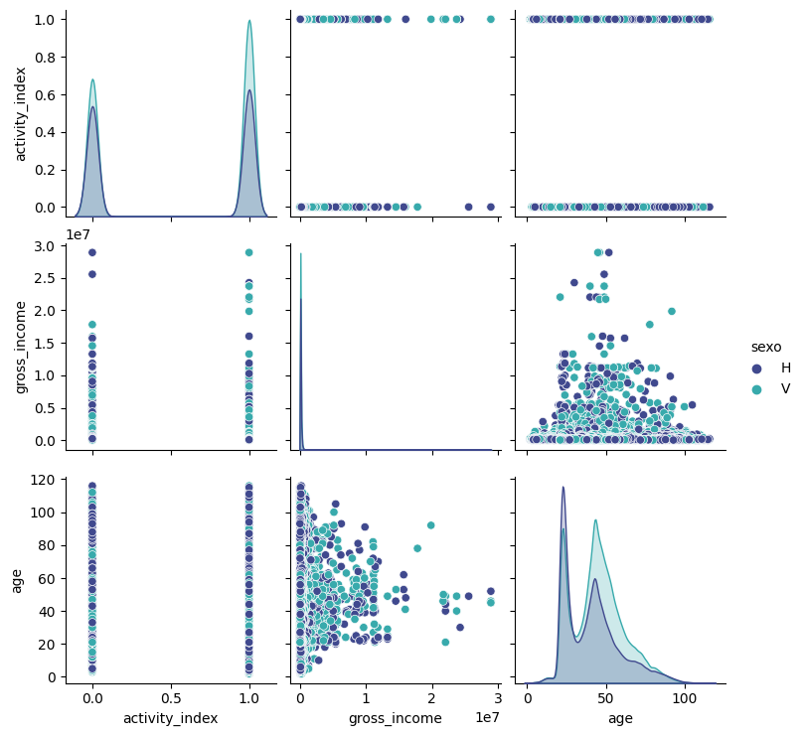
Exploratory Data Analysis (EDA)
Distribution of 'cost index, gross income and age' by gender

Slide 32
Recommendations
Final Recommendation
A model can be built using the K-means method for customer segmentation and the Elbow method for determining the number of clusters.
K-Means Clustering Algorithm: The KMeans model is an unsupervised machine learning model that works by simply splitting N observations into K numbers of clusters. The observations are grouped into these clusters based on how close they are to the mean of that cluster, which is commonly referred to as centroids.
Specify number of clusters K.
Initialize centroids by first shuffling the dataset and then randomly selecting K data points for the centroids without replacement.
Keep iterating until there is no change to the centroids. i.e assignment of data points to clusters isn’t changing.

Slide 33
Thank You

